Slide 1

Decent Work And Economic Growth
"Empowering people through quality employment for a thriving future."

Slide 2

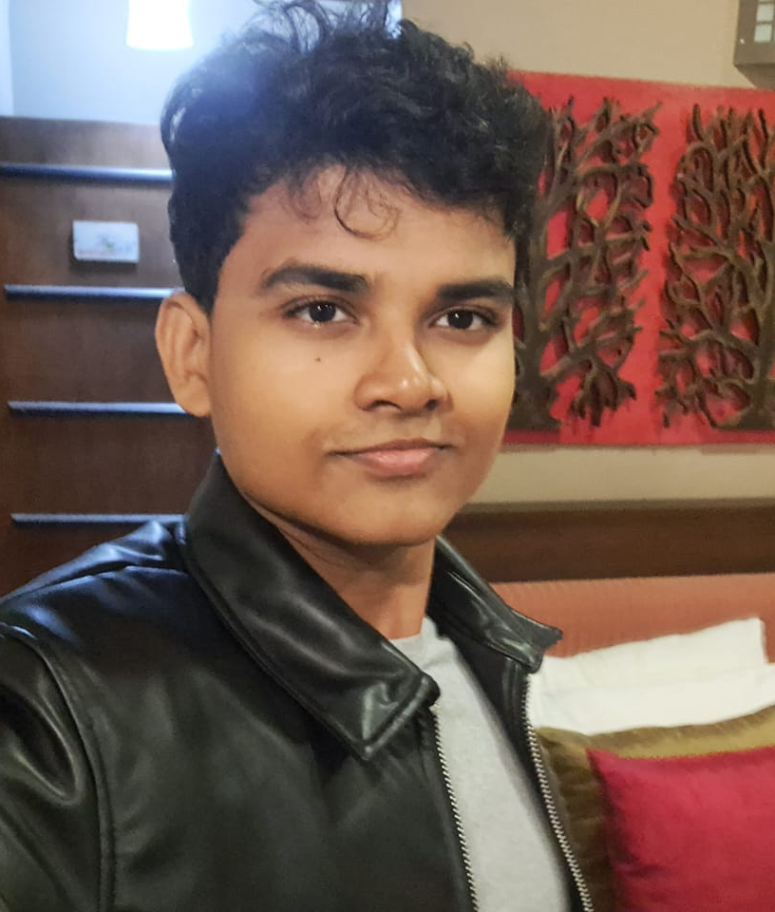
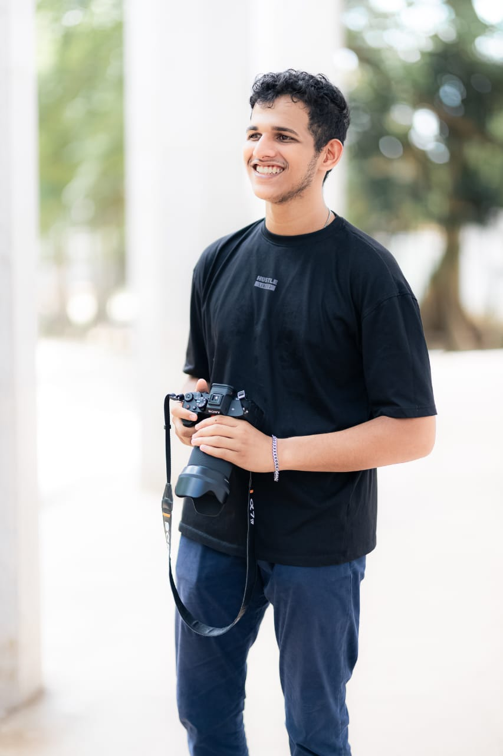

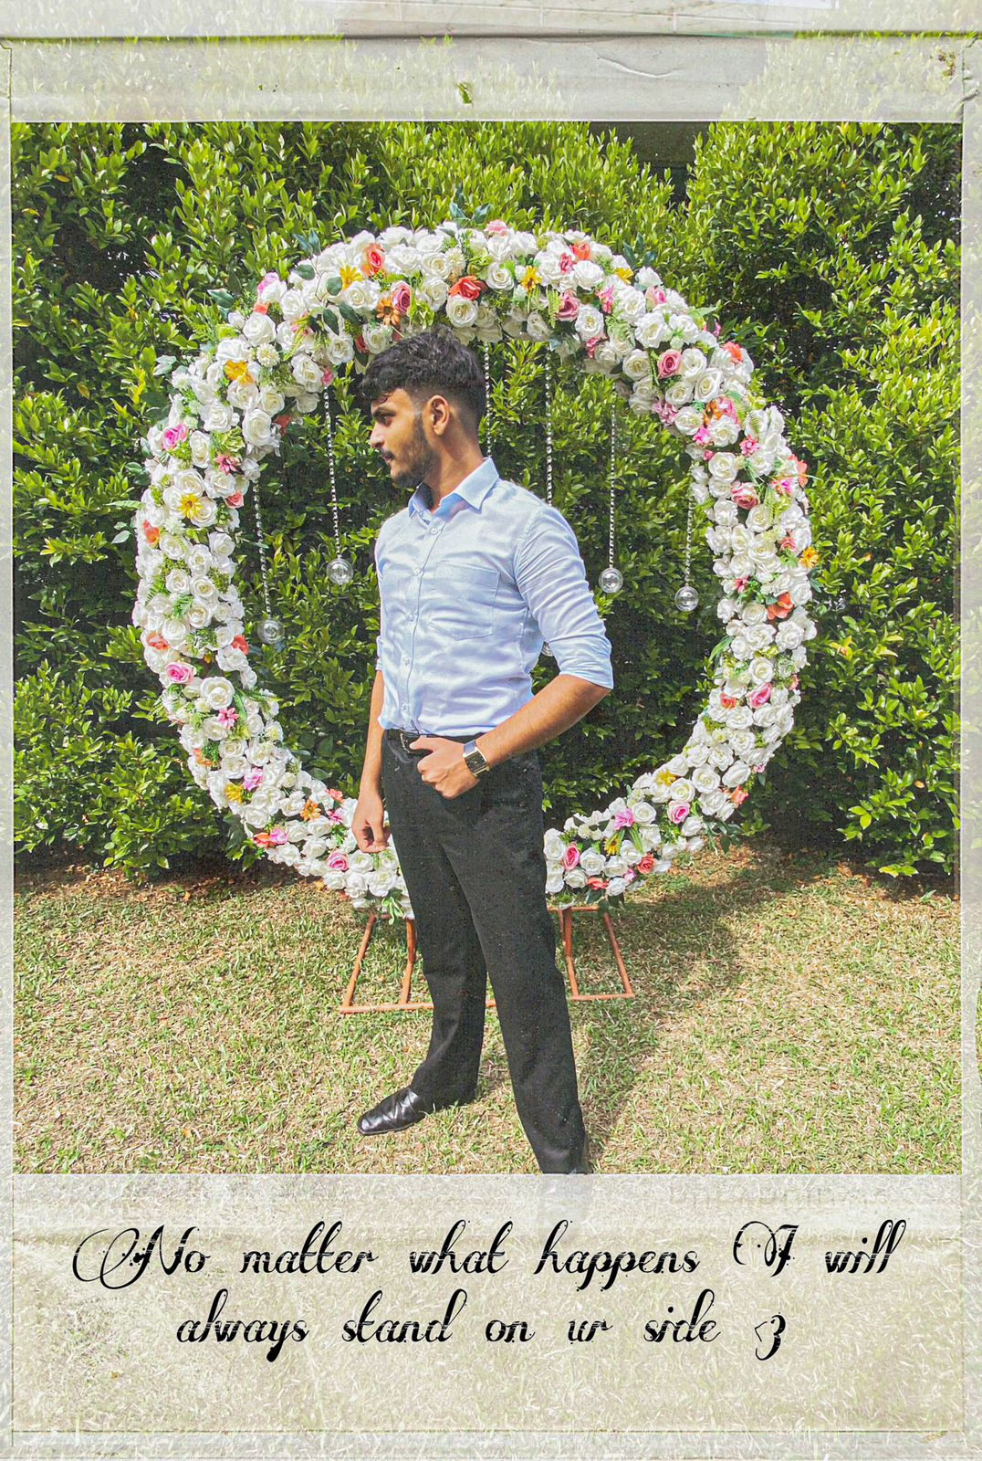
OUR TEAM
NAME – Disandu Perera
UOW ID - w2052093
IIT ID - 20220794
NAME – Bihandu Methsilu
UOW ID – w2053763
IIT ID - 20222346
NAME – Vidura Baddage
UOW ID – w2051870
IIT ID - 20231067
NAME – Dineth Jayasuriya
UOW ID – w2052288
IIT ID - 20220601

Slide 3


Problem Definition
In today’s fast-paced business world, organizations and individuals struggle to find the right talent that meets their needs.
Traditional recruitment platforms often lack personalization, making it difficult for professionals to showcase unique skills and for businesses to find specialized talent efficiently.
This leads to lost opportunities, reduced productivity, and slower growth.

Slide 4
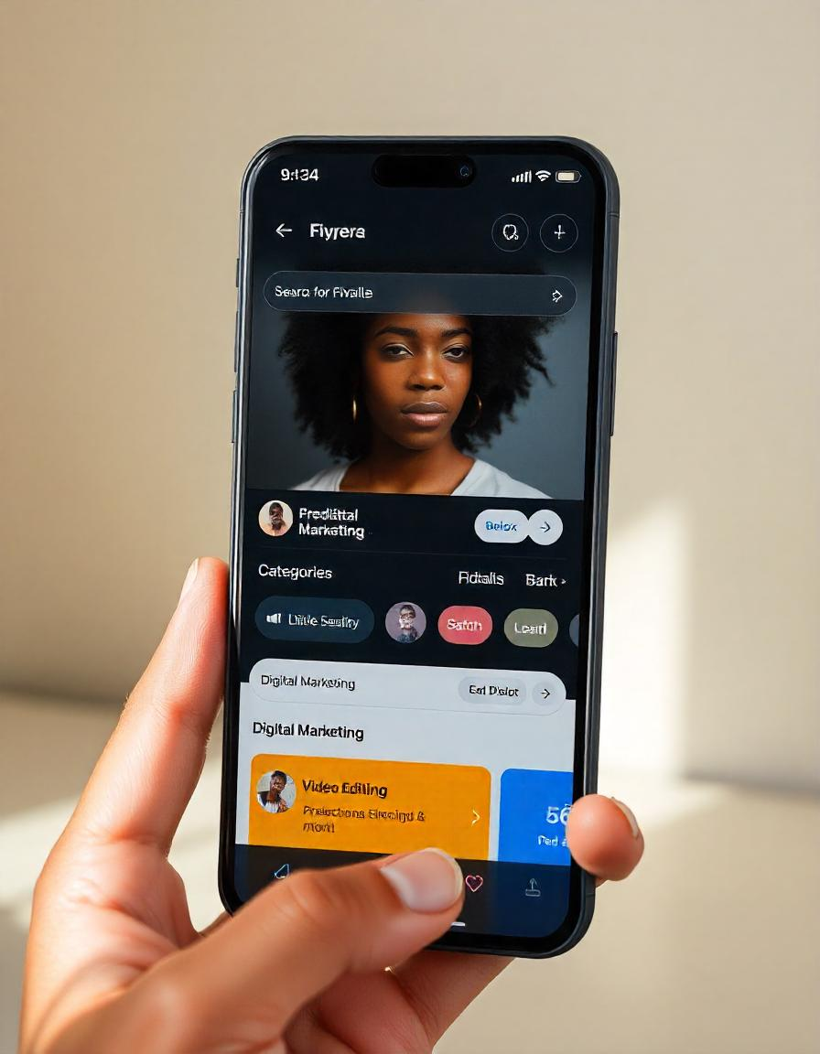
Our Proposed Solution
Our app connects businesses with freelancers in creative services, eco-friendly consulting, and tech support.
It features enhanced profiles with portfolios, video intros, and verified skills, supported by AI-driven matching for relevant connections.
Trust is built through verified reviews, background checks, and real-time tracking. Gamification, video calls, and collaborative workspaces enhance engagement.
With flexible pricing and customizable profiles, our platform fosters a trust-driven marketplace for growth-oriented collaborations.

Slide 5
Our Features
Niche Service Categories for Specialized Needs
Enhanced Freelancer Profiles for Deeper Insights
AI-Powered Matching for Optimal Client-Talent Fit
Transparency Features for Accountability and Trust
Gamification to Encourage Engagement and Growth
Customizable Communication Tools for Collaboration
Personalized Portfolios for Showcasing Expertise

Slide 6

Niche Service Categories for Specialized Needs
Specialized Expertise
Explore our diverse range of niche service categories, from cutting-edge software development to specialized creative services.
Our platform matches you with the most qualified freelancers for your unique business requirements, ensuring a perfect fit.
Effortlessly browse, hire, and manage specialized talent through our intuitive and user-friendly interface.

Slide 7

Enhanced Freelancer Profiles for Deeper Insights
Comprehensive Profiles
Unlock in-depth insights into each freelancer's expertise, experience, and past work samples to make informed hiring decisions.
Verified Credentials
Trust that your chosen talent has the necessary qualifications and certifications to deliver exceptional work.
Ratings and Reviews
Genuine feedback from previous clients helps you identify the most reliable and skilled freelancers for your needs.
Personalized Portfolios
Explore customized portfolios that showcase each freelancer's unique style and expertise, giving you a deeper understanding of their capabilities.

Slide 8

AI-Powered Matching for Optimal Client-Talent Fit
Skills Analysis
Our advanced AI algorithms meticulously analyze each freelancer's skills, experience, and past performance.
Seamless Hiring
With just a few clicks, you can easily hire the most suitable freelancer for your project, ensuring a perfect client-talent match.
Personalized Recommendations
The platform then leverages this data to provide personalized talent recommendations tailored to your unique project requirements.

Slide 9
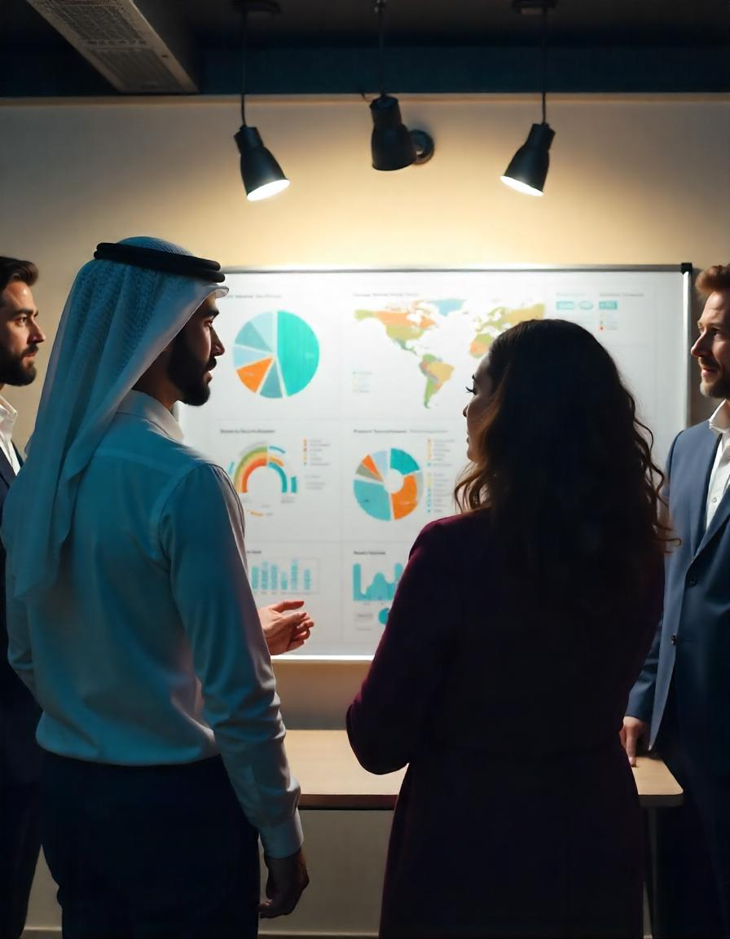
Transparency Features for Accountability and Trust
1
Real-Time Tracking
Stay updated on project progress with our transparent, real-time tracking capabilities.
2
Milestone Monitoring
Collaborate closely with freelancers and ensure timely deliverables through our milestone-based workflow system.
3
Comprehensive Reporting & Secure Payments
Access detailed reports and analytics to gain valuable insights into your projects and freelancer performance, While also enjoying peace of mind with our secure payment gateway and escrow services, protecting both clients and freelancers.

Slide 10
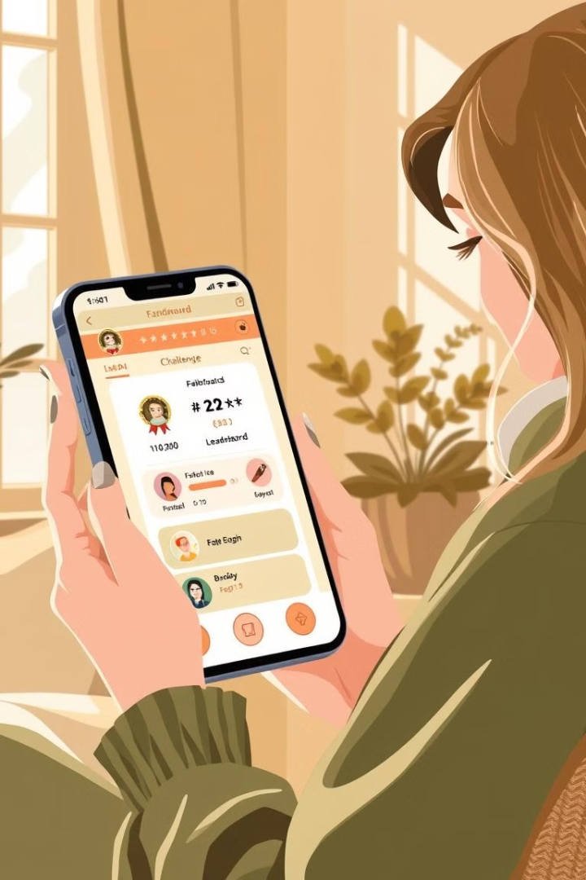




Gamification to Encourage Engagement and Growth
Achievements
Leaderboards
Earn badges and rewards for completing tasks, building your reputation, and reaching new milestones.
Track your progress and stay inspired by comparing with top freelancers and clients.
Interactive Challenges
Engagement
Build connections and collaborate within our vibrant community of professionals.
Engage in skill-building exercises and interactive challenges to continuously improve your expertise.

Slide 11
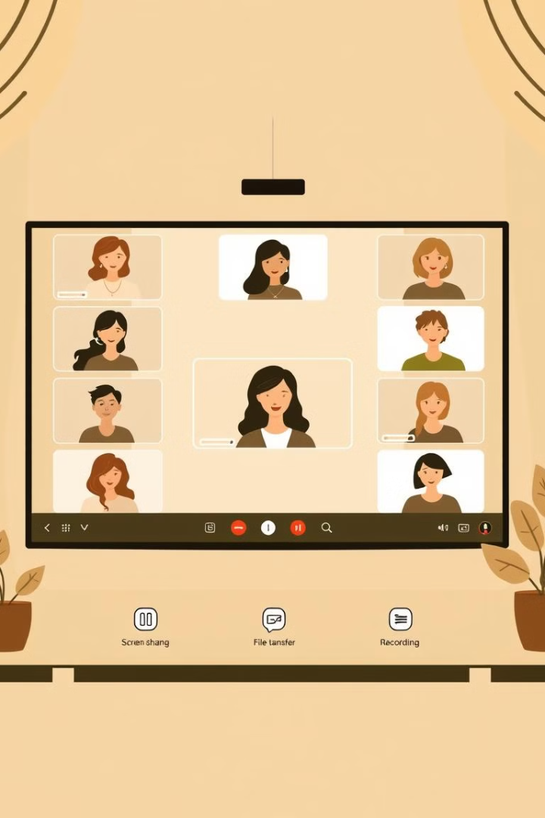



Customizable Communication Tools for Collaboration
Seamless Messaging
Streamline communication with real-time chat, file sharing, and project-specific messaging channels.
Video Conferencing
Conduct face-to-face meetings and remote collaboration sessions through our secure video call capabilities.
Project Management
Stay organized and on track with our integrated project management tools, task boards, and timelines.

Slide 12
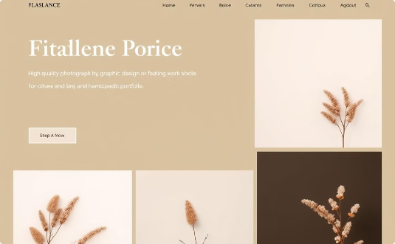
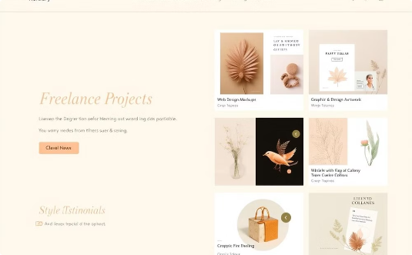
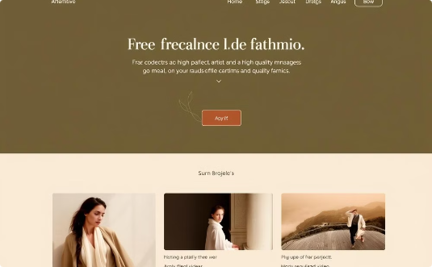
Personalized Portfolios for Showcasing Expertise
Customizable Design
Project Showcase
Multimedia Presenting
Highlight your best work samples, client testimonials, and professional achievements to impress potential clients.
Combine text, images, and videos while creating a compelling and engaging portfolio experience.
Create a unique and visually appealing portfolio that reflects personal brand and style.

Slide 13
Thank You !
Any Questions?

